Slide 1

Project 2
Predicting home sale prices in Ames, Iowa
Shauna, Kar how, Willy, Ikhwan

Slide 2


Business Objective
We are property agents from an established real estate firm. We hope to provide value add to our clients by providing reliable and accurate insights into the house prices of Ames, Iowa, through our prediction service.

Slide 3
Modelling Approach
Data cleansing
Exploratory Data Analysis
Feature Engineering (Interaction Terms)
Feature Selection
Linear Modelling
Regularization
Prediction Outcome

Slide 4
Data Cleansing
Drop non-features e.g. PID, ID
Drop high number of null values
Drop high number of zeros
Data Types
Invalid categorical values
Develop utility functions to cross-reference categorical values to data dictionary to highlight problems.

Slide 5
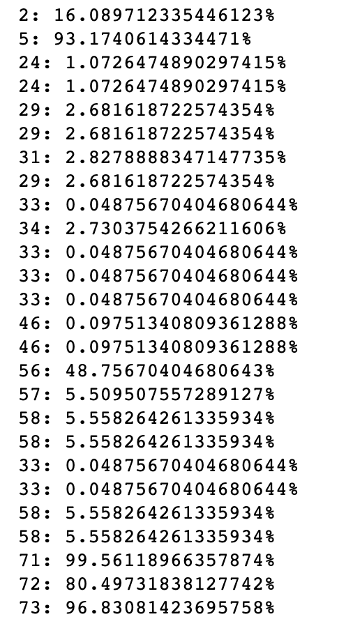
Data Cleansing
Columns 5, 56, 71, 72, 73 have too many null / zero values so we drop features:
Alley, Fireplace Qu, Pool Qc,Fence, Misc Feature

Slide 6
Data Types
Categorical features with numeric values e.g. Mo Sold
Yr Sold, Year Built represent years, numeric but more categorial.
Can be converted to more meaningful data i.e. Yr Sold - Year Built = Age @ time of sales.
Discrete numeric columns with float data type e.g. Bsmt Full Bath

Slide 7
Invalid Categorical Values
Reference data documentation http://jse.amstat.org/v19n3/decock/DataDocumentation.txt
Whitespaces
e.g. Sale Type: 'WD '
Spelling Mistakes
e.g. CmentBd: CemntBd
Invalid values
e.g. MS Zoning: A (agr), C (all), I (all)
External resources
i.e. Google Maps, Ames City Map
e.g. Neighborhood: Greens = Greeensborro, Sommerset district (Somerst)

Slide 8
Utility Functions
valid_values = {
'MS SubClass': [20, 30, 40, 45, 50, 60, 70, 75, 80, 85, 90, 120, 150, 160, 180, 190],
'MS Zoning': ['RL', 'RM', 'FV', 'C', 'RH', 'A', 'I', 'RP'],
'Street': ['Pave', 'Grvl'],
'Alley': ['Pave', 'Grvl', 'NA']...
# Iterate through all categorical features and check for invalid values
for index, error in enumerate(check_invalid_values(df, valid_values), 1):
print( str(index) + ': ' + error)
1: Invalid Bldg Type value: Twnhs
2: Invalid Exterior 2nd value: Brk Cmn
3: Invalid Exterior 2nd value: CmentBd
4: Invalid Exterior 2nd value: Wd Shng
5: Invalid MS Zoning value: A (agr)
6: Invalid MS Zoning value: C (all)

Slide 9
EDA & Feature Selection
Categorical -> Chi square test (to remove collinearity), followed by the creation of dummy variables
Numeric -> correlation plot
Feature matrix -> categorical +numeric
Target vector-> sale price

Slide 10
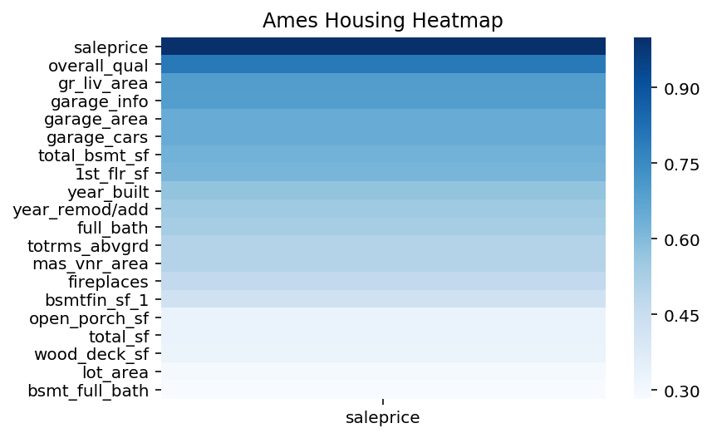
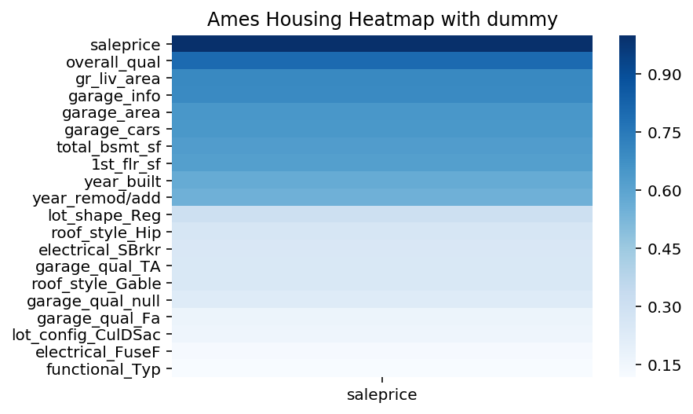
EDA & Feature Selection

Slide 11
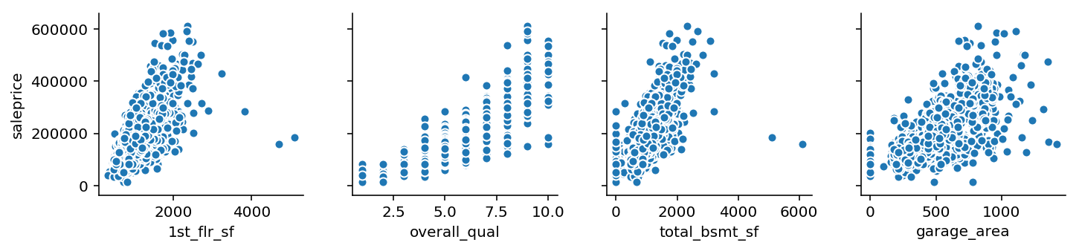
EDA & Feature Selection
Pairplot of top correlated numeric variables

Slide 12
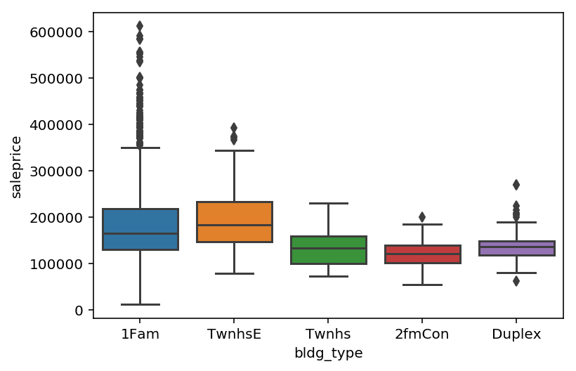
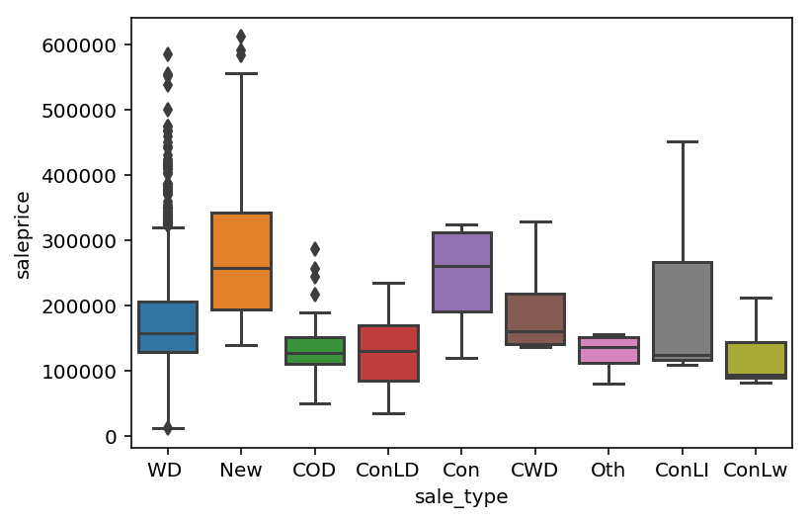
EDA & Feature Selection
Interesting categorical variables

Slide 13
Feature Engineering
Interaction Terms
Total square foot -> total basement square foot, 1st floor square foot, 2nd floor square foot
Total bath -> basement full bath, basement half bath, full bath, half bath
Garage Info -> garage year built, garage cars, garage area

Slide 14
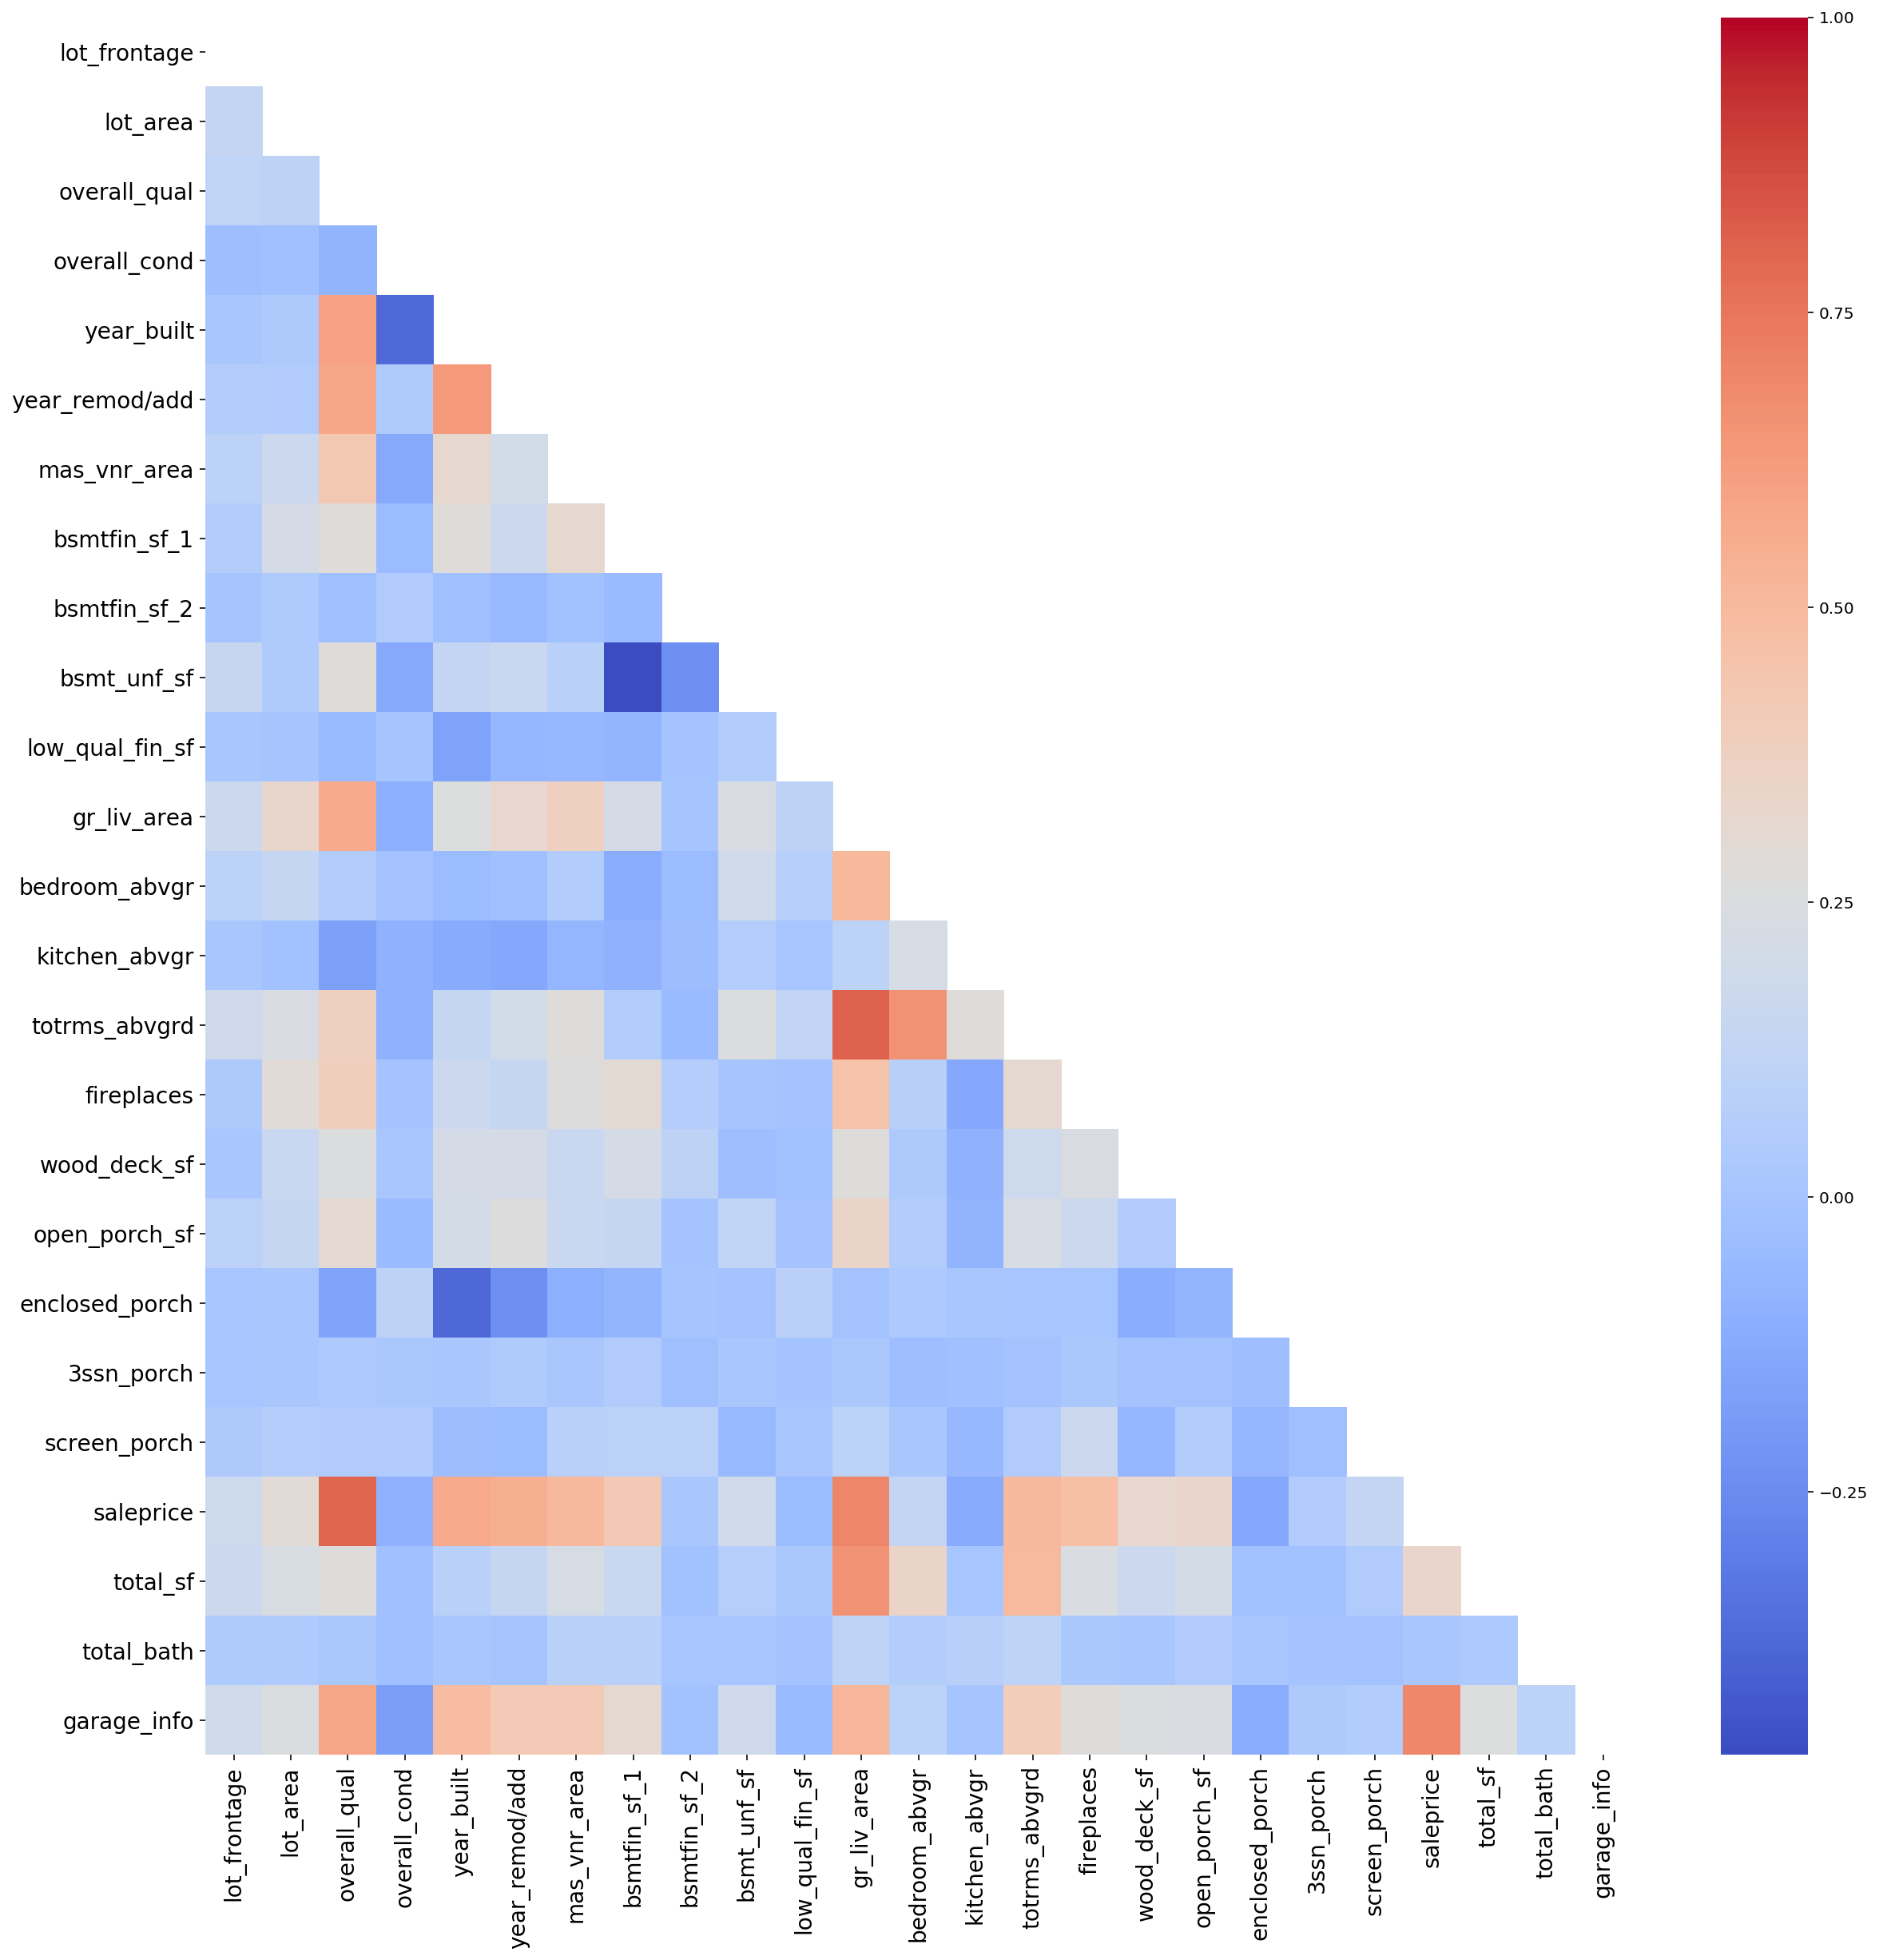
Useful Interaction Terms
Feature | Correlation Coef
Total Bath | 0.0163
Full Bath | 0.538
Half Bath | 0.283
Basement full bath | 0.283
Basement half bath | 0.0453
Total Sq Ft | 0.333
Basement Sq Ft | 0.191
1st Floor Sq Ft | 0.618
2nd Floor Sq Ft | 0.248
Garage Info | 0.695
Garage Year Built | 0.259
Garage Cars | 0.648
Garage Area | 0.650

Slide 15
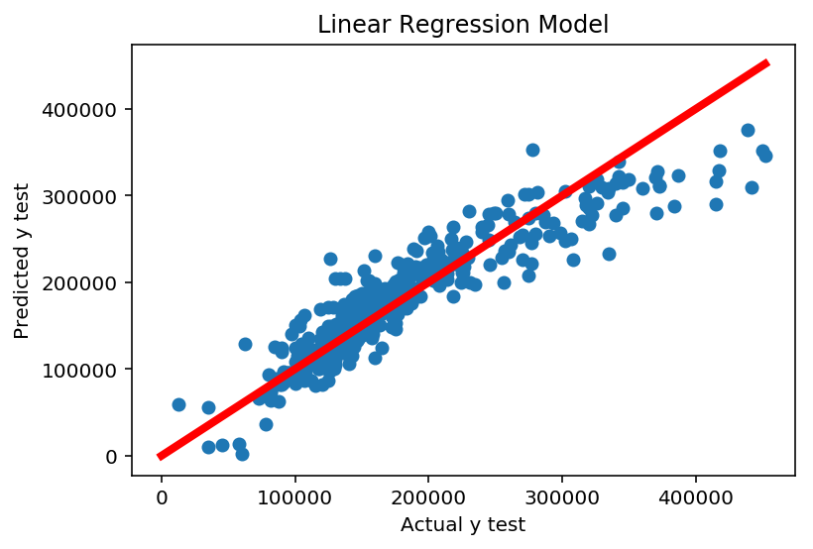
Regression Model
Baseline Linear Regression Model: Mean CV score: 0.805
RidgeCV: after scaling data Mean CV score (Train/Test) : 0.782/0.811
LassoCV: after scaling data Mean CV Score (Train/Test) : 0.783/0.815

Slide 16
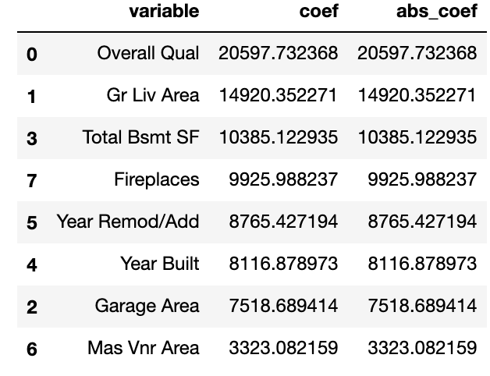
Prediction Outcome
CONCLUSION
- With features and coefficients known:
- We can predict price of House
- determine which factors affect price most
-Given a particular price , what features of a house can be built to meet that price.

Slide 17
Thank you!

